Slide 1


Digital Strategy

Slide 2
GE Digital

Slide 3
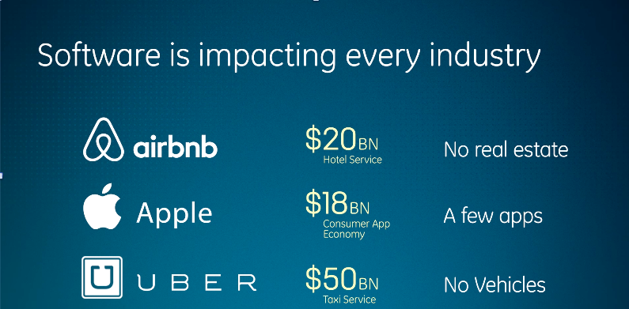

Slide 4
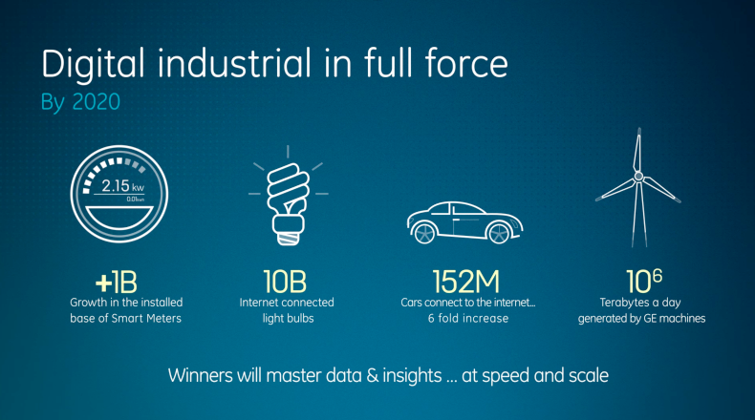

Slide 5
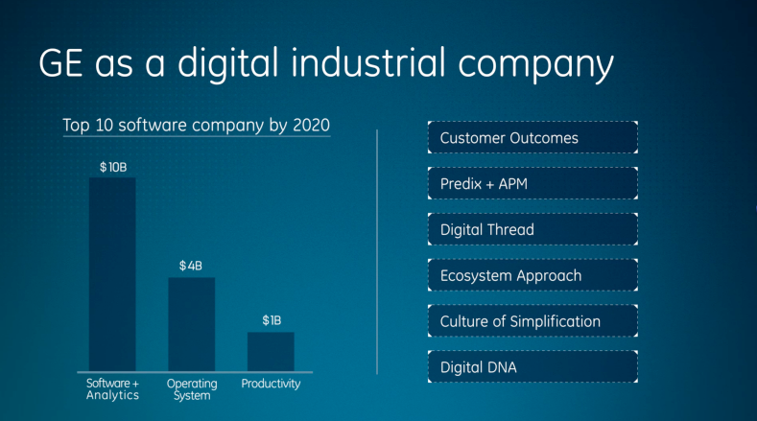

Slide 7
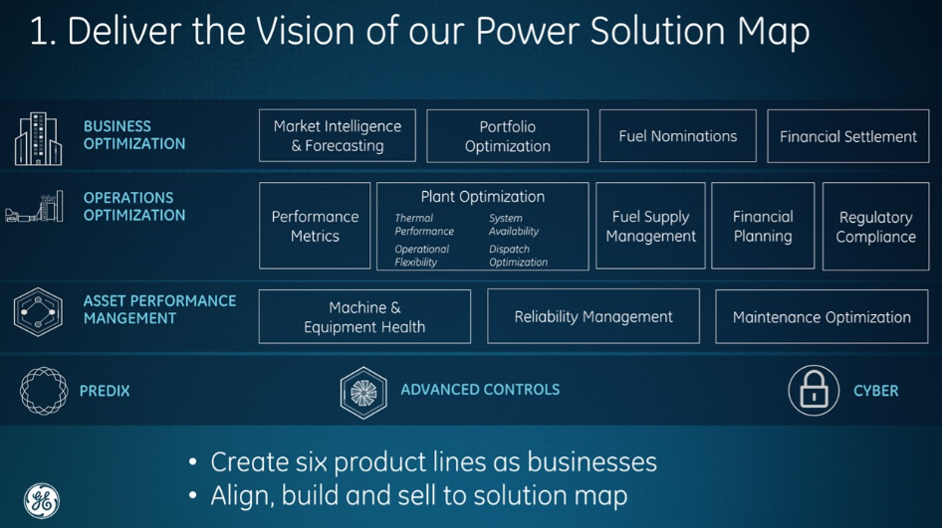

Slide 8
Water & DP Digital strategy

Slide 9
Defining Water Digital & Digital Vision
Draft mission: Connecting people, systems, and machines with information to create frictionless experiences and better customer outcomes .
To do this, we must:
Interact with customers proactively and responsively through non-voice methods
Offer the right info to the right audience at the right time… anywhere
Understand behaviors and outcomes with statistical analysis (why vs what)
Find opportunities to disrupt GE Water from the outside in

Slide 10
Digital Development
Context
Q2 Deliverables
Fragmented digital programs
Cohesive projects w/ measurable value
Digital projects have equal status
Priority based on business value
Digital Solutions separate unit to develop digital thread and drive new business models
Digital an enabler for core P&Ls and incremental improvement
Multiple digital leaders and programs across P&Ls and functions
ONE process for digital development, across ALL Water, in ALL regions, encompassing ALL verticals

Slide 11
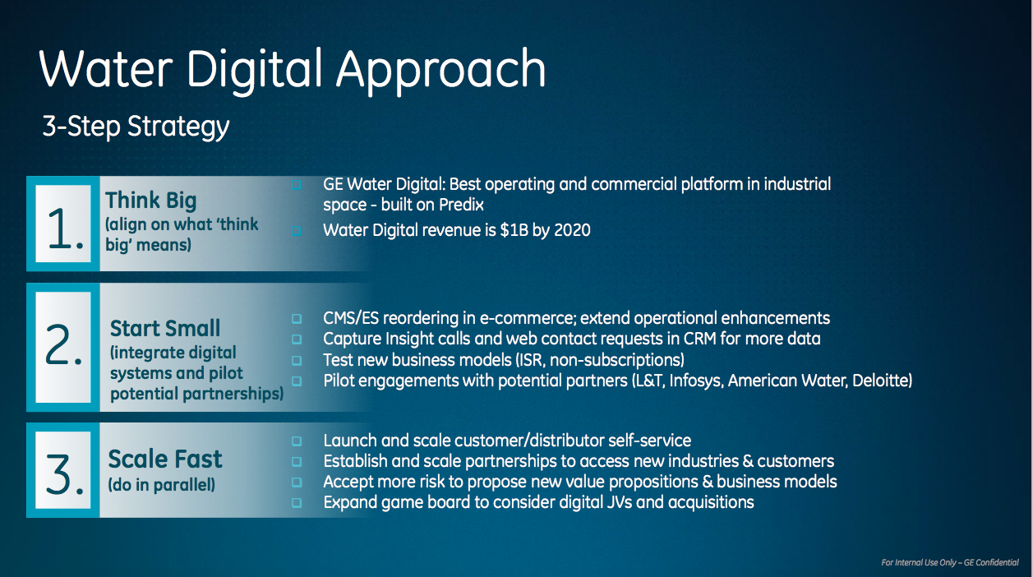

Slide 12
Water Digital Industrial
2016 Priorities:
Integrate systems and extend digital thread
Tie Power Digital efforts across APM, services & E-Commerce
Accelerate Insight move to Predix, manage Opex
Grow assets under management (AUM)
Platform cybersecurity
Find synergy opportunities with Distributed Power

Slide 13
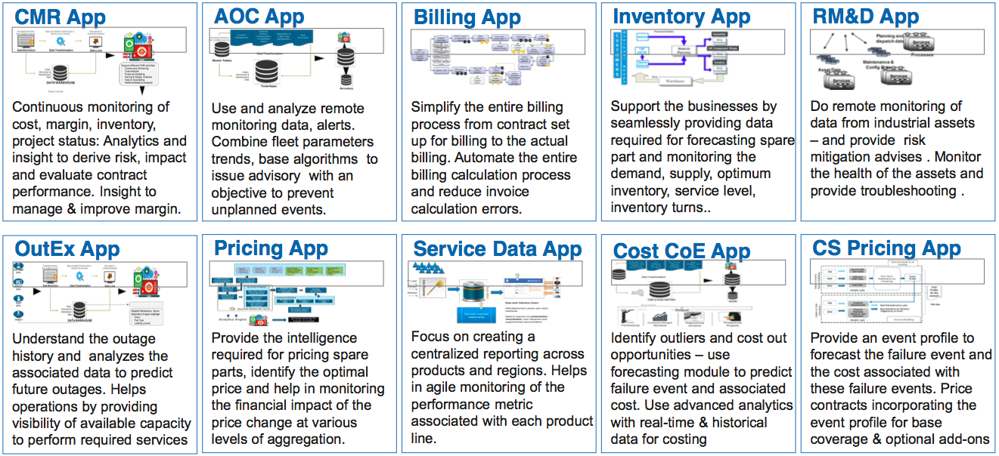
Potential Micro Services / Apps GE Predix

Slide 14
Insight roadmap

Slide 15
Appendix

Slide 16
Value Strategy
Benefit Strategy
Automate work and empower employee: Mobility, access to info, streamlined parts, right skills the first time
Labor savings,
Material savings,
Cash flow
Operations
Atomize & automate work: Equipment quality & reliability, Mobilization speed,
Increased sales,
Labor savings,
Material savings
Maintenance
Empower & relieve: reduce non-value tasks, eliminate contract leakage
Labor savings,
Improved margins
Contract
Help when in trouble: speedier issue resolution & identification of systemic issues
Labor savings,
Reduced IT costs
Quality
Serve & optimize: empower customers through customer community
Increased sales,
Labor savings
Self Serve

Slide 17
